Slide 1

P peline
The Data
Machine Learning II: Decision Trees & Naïve Bayes
© Jennifer Mankoff
The Data Pipeline; HCII; Spring 2014
Slides modified & borrowed from Carolyn Rosé
Want to go deeper? http://see.stanford.edu/see/lecturelist.aspx?coll=348ca38a-3a6d-4052-937d-cb017338d7b1

Slide 2
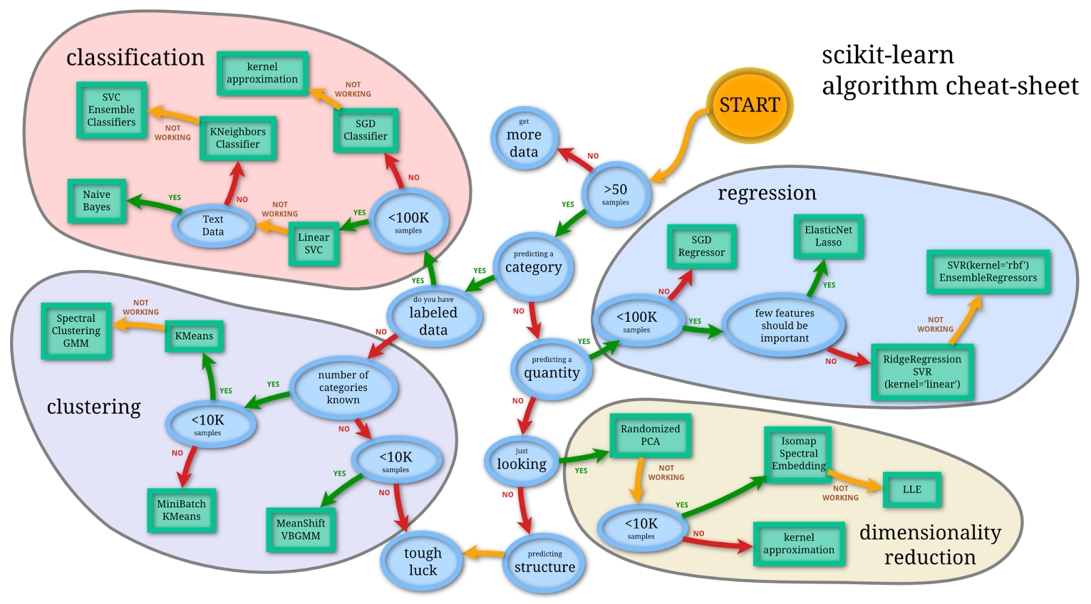
Selecting algorithms
http://www.quora.com/What-are-the-advantages-of-different-classification-algorithms

Slide 3
Classification (Learning) Algorithms
Two of the simplest alg. tend to give very good results on discrete (non-sequence) classification
Efficient training and classification time
Comparatively simple and easy to use (not a lot of parameters to set, etc.)
Naïve Bayes
Decision Trees

Slide 4
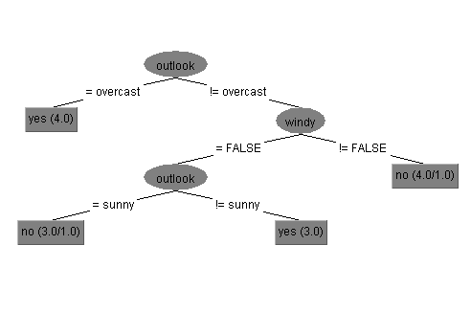
How Decision Trees Work
Notes:
Uses simple nested conditional structure
Tree structured
At each interior node we look at one feature
Value of this feature selects a sub-tree for making the rest of the decision (so edges are labeled with feature values)
At leaves we make a classification (assign the class)

Slide 5
How Decision Trees Work
Each interior node looks at one feature
Notes:
Uses simple nested conditional structure
Tree structured
At each interior node we look at one feature
Value of this feature selects a sub-tree for making the rest of the decision (so edges are labeled with feature values)
At leaves we make a classification (assign the class)

Slide 6
How Decision Trees Work
Feature value selects which subtree to traverse
Notes:
Uses simple nested conditional structure
Tree structured
At each interior node we look at one feature
Value of this feature selects a sub-tree for making the rest of the decision (so edges are labeled with feature values)
At leaves we make a classification (assign the class)

Slide 7
How Decision Trees Work
Leaves specify the classification
Notes:
Uses simple nested conditional structure
Tree structured
At each interior node we look at one feature
Value of this feature selects a sub-tree for making the rest of the decision (so edges are labeled with feature values)
At leaves we make a classification (assign the class)

Slide 8
Easy to train recursively
BuildTree(trainingSet)
// base case … (more base cases later)
If trainingSet only has one label on all instances
Return new Leaf(trainingSet.label)
// recursive case
Pick a feature Fn we haven’t split with before // … how?
result = new SplitNode(Fn)
For each value unique value f_{i} of feature Fn
trainSubset= subset of trainingSet with Fn= f_{i}
result.addChild(BuildTree(trainSubset))
Return result
(Note: “standard” algorithm is C4.5 [Quinlan 93])

Slide 9
Decision Trees
How do we pick features to base splits on?
Some features might be mostly noise (not very predictive of label)
splitting with doesn’t narrow down your decision much
Other features might have high information content
Notes:
Intuitively would like the features with the most information in them
Turns out there is a nice information theoretic way to estimate this: “Information Gain”
… will need a short trip into information theory

Slide 10
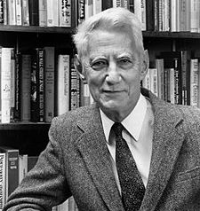
Information Entropy
(AKA Shannon Entropy):
a measure of uncertainty
Less uncertainty (less entropy) → more predictable → less information
Provides a lower bound on the average number of bits needed to encode / transmit something
Intuitively: proportional to how much information is in the thing to be transmitted
Claude Shannon (1916-2001) The father of information theory

Slide 11
Information Entropy
Assume a discrete random variable X w/ values {x₁,x₂…,x_{n}}
Uncertainty u_{i} associated with x_{i} (the number of bits needed to designate x_{i} in a message) defined as :
If X was uniformly distributed [P(x_{i}) = 1/n]:
u_{i} = log₂ n
For arbitrary non-uniform distribution:
u_{i} = log₂(1/P(x_{i})) = - log₂P(x_{i})
Entropy gives the average number of bits to encode a message of symbols drawn from X
Entropy(X) = H(X) = P(x₁) u₁+ P(x₂) u₂ +…+ P(x_{n}) u_{n}
= - ∑_{i=1..n} P(x_{i}) log₂ P(x_{i})

Slide 12
Aside: Probability and Probability Notation
Have some set of things we are interested in
A particular universe of things
Let’s say: “Jen’s current activity (during a weekday)” which can be: {Biking, Vehicle, Walking, Still, Other}
P(Still)
“probability of Still”
..
U
Still
Notes:
- the probability that if we sample randomly from our universe we will see A

Slide 13
Aside: Probability and Probability Notation
Have some set of things we are interested in
A particular universe of things
Let’s say: “Jen’s current activity (during a weekday)” which can be: {Biking, Vehicle, Walking, Still, Other}
P(Still)
“probability of Still”
P(A) = |A|
|U|.
U
Still
Notes:
- the probability that if we sample randomly from our universe we will see A
Note: at the smallest A is empty (|A| = 0)
at the largest A is all of U (|A| = |U|)
so: 0 ≤ P(A) ≤ 1

Slide 14
Probability and Probability Notation
Examples:
P(sleeping) = 8*5 = 0.25
24*5
P(lecture) = 3 = 0.025
120
P(meeting) = 15 = 0.125
120
Note: at the smallest A is empty (|A| = 0)
at the largest A is all of U (|A| = |U|)
so: 0 ≤ P(A) ≤ 1

Slide 15
Information Entropy
Assume a discrete random variable X w/ values {x₁,x₂…,x_{n}}
Uncertainty u_{i} associated with x_{i} (the number of bits needed to designate x_{i} in a message) defined as :
If X was uniformly distributed [P(x_{i}) = 1/n]:
u_{i} = log₂ n
For arbitrary non-uniform distribution:
u_{i} = log₂(1/P(x_{i})) = - log₂P(x_{i})
Entropy gives the average number of bits to encode a message of symbols drawn from X
Entropy(X) = H(X) = P(x₁) u₁+ P(x₂) u₂ +…+ P(x_{n}) u_{n}
= - ∑_{i=1..n} P(x_{i}) log₂ P(x_{i})

Slide 16
Information Entropy
Assume a discrete random variable X w/ values {x₁,x₂…,x_{n}}
Uncertainty u_{i} associated with x_{i} (the number of bits needed to designate x_{i} in a message) defined as :
If X was uniformly distributed [P(x_{i}) = 1/n]:
u_{i} = log₂ n
For arbitrary non-uniform distribution:
u_{i} = log₂(1/P(x_{i})) = - log₂P(x_{i})
Entropy gives the average number of bits to encode a message of symbols drawn from X
Entropy(X) = H(X) = P(x₁) u₁+ P(x₂) u₂ +…+ P(x_{n}) u_{n}
= - ∑_{i=1..n} P(x_{i}) log₂ P(x_{i})

Slide 17
Information Entropy
Assume a discrete random variable X w/ values {x₁,x₂…,x_{n}}
Uncertainty u_{i} associated with x_{i} (the number of bits needed to designate x_{i} in a message) defined as :
If X was uniformly distributed [P(x_{i}) = 1/n]:
u_{i} = log₂ n
For arbitrary non-uniform distribution:
u_{i} = log₂(1/P(x_{i})) = - log₂P(x_{i})
Entropy gives the average number of bits to encode a message of symbols drawn from X
Entropy(X) = H(X) = P(x₁) u₁+ P(x₂) u₂ +…+ P(x_{n}) u_{n}
= - ∑_{i=1..n} P(x_{i}) log₂ P(x_{i})

Slide 18
Conditional Entropy
Specific Conditional Entropy
Entropy(F_{a} | F_{b} = x_{i})
Entropy of feature F_{a} among instances in which feature F_{b} = x_{i}
Conditional Entropy across the full training set
Entropy(Y | X): average specific conditional entropy of Y
Entropy in Y if X is known
Also expected number of bits to transmit Y if both sides already know the value of X
Entropy(Y | X) = ∑_{i=1..n} P(X= x_{i}) Entropy(Y | X = x_{i})

Slide 19
Information Gain (AKA Mutual Information or Kullback-Leibler divergence)
IG(Y | X) = Entropy(Y) – Entropy(Y | X) also given as IG(Y, X) and I(Y;X)
Reduction in entropy of Y (uncertainty about Y) by knowing X
If I need to transmit Y, how many bits on average would it save me if both sides already new X
If I am predicting Y how much information does X provide
Case we are interested in: IG(Label | Feature)
Higher IG for a feature indicates more information about the label is in that feature
– Very useful for feature selection!

Slide 20
Impact on Decision Trees…
BuildTree(trainingSet)
// base case … (more base cases later)
If trainingSet only has one label on all instances
Return new Leaf(trainingSet.label)
// recursive case
Pick a feature Fn we haven’t split with before // … how?
result = new SplitNode(Fn)
For each value unique value f_{i} of feature Fn
trainSubset= subset of trainingSet with Fn= f_{i}
result.addChild(BuildTree(trainSubset))
Return result
(Note: “standard” algorithm is C4.5 [Quinlan 93])

Slide 21
Impact on Decision Trees…
BuildTree(trainingSet)
// base case … (more base cases later)
If trainingSet only has one label on all instances
Return new Leaf(trainingSet.label)
// recursive case
Pick a feature Fn we haven’t split with before // … how?
result = new SplitNode(Fn)
For each value unique value f_{i} of feature Fn
trainSubset= subset of trainingSet with Fn= f_{i}
result.addChild(BuildTree(trainSubset))
Return result
Split with feature having the largest IG
(Note: “standard” algorithm is C4.5 [Quinlan 93])

Slide 22
Impact on Decision Trees…
BuildTree(trainingSet)
// base case … (more base cases later)
If trainingSet only has one label on all instances
Return new Leaf(trainingSet.label)
// recursive case
Pick a feature Fn we haven’t split with before // … how?
result = new SplitNode(Fn)
For each value unique value f_{i} of feature Fn
trainSubset= subset of trainingSet with Fn= f_{i}
result.addChild(BuildTree(trainSubset))
Return result
Split with feature having the largest IG
… Stop when gain is small to avoid overfitting
(Note: “standard” algorithm is C4.5 [Quinlan 93])
Notes:
(Note: “standard” algorithm is C4.5 [Quinlan 93])

Slide 23
Decision Trees – Overfitting
Algorithm will subdivide all the way down to single training instances to exactly “fit” training data
But doing well on training data doesn’t guarantee doing well on new data
Small numbers of training instances don’t generalize well (“noisy”)
Decision trees are particularly prone to overfitting
“Pruning” can help (typically done after tree construction)

Slide 24
Minimum description length principle
The simplest model that fits your data will generalize better
Complex models are more likely to over-fit
Decision trees can become complex when you try to optimize performance on training data
Sometimes 0R/1R are best!
The best algorithm for your data will give you exactly the power you need

Slide 25
Prepruning versus Postpruning
Prepruning: knowing when to stop growing a tree
Hard to do because sometimes the value of a feature doesn’t become clear until lower down on the tree
Interactions between features
You always have to have a stopping criterion, so in some sense you are doing prepruning
But in practice you over-shoot and then do post-pruning

Slide 26
Prepruning versus Postpruning
Postpruning: simplifying a tree after it is built
Easier because hindsight is 20/20
Less efficient because you might have done a lot of work that you’re going to throw away now

Slide 27
Reduced Error Pruning
Estimate the error rate at each node of both the original and resulting tree (after pruning)
Prune when the error goes up on an optimization set
Won’t work to use the training set to compute the error rate because the original tree was optimized over this set already
You can hold back some of the training data for an optimization set to use for pruning

Slide 28
Using Confidence Factors to Estimate Error
Confidence factor = .25
Means you are 75% sure the error rate is within the interval.
(
)
Estimate error based on training data
If it is within the interval, prune
Notes:
Similar principle to computing confidence
Lowering the confidence value causes more pruning
We use the estimate “pessimistically” by using the upper confidence limit on the error estimate

Slide 29
Using Confidence Factors to Estimate Error
Confidence factor = .25
Means you are 75% sure the error rate is within the interval.
(
)
Estimate error based on training data
If it is within the interval, prune
Notes:
We use the estimate “pessimistically” by using the upper confidence limit on the error estimate

Slide 30
Lowering confidence causes more pruning
Confidence factor = .25
Means you are 75% sure the error rate is within the interval.
(
)
Confidence factor = .10
Means you are 90% sure the error rate is within the interval.
(
)
Lowering the confidence value causes more pruning
Notes:
Similar principle to computing confidence
Lowering the confidence value causes more pruning
We use the estimate “pessimistically” by using the upper confidence limit on the error estimate

Slide 31
Thinking about the Confidence Factor
More error expected: We’ve only used one feature to at this point
[10A, 10B]
[5A,1B]
[5A,10B]
Less error expected: We have used more information to make a decision
[5A,2B]
[0A,7B]
(
)
Confidence factor = .10: You are 90% sure the error rate is within the interval.

Slide 32
Thinking about the Confidence Factor
More error expected: We’ve only used one feature to at this point
[10A, 10B]
[5A,1B]
For the difference in errors, is |t| < |t| ?
[5A,10B]
Less error expected: We have used more information to make a decision
[5A,2B]
[0A,7B]
(
)
Confidence factor = .10: You are 90% sure the error rate is within the interval.
Notes:
If the difference is big enough then we feel it is worth the risk of additional complexity/overfitting
Otherwise we cannot conclude that the difference in accuracy is real

Slide 33
Decision Trees Pros and Cons
Open world assumption
Only examine some attributes
Beyond that can use the majority class to decide
Divide and conquer approach
Global maximization of performance at each iteration
Prone to overfitting. Pruning important for maximizing performance

Slide 34
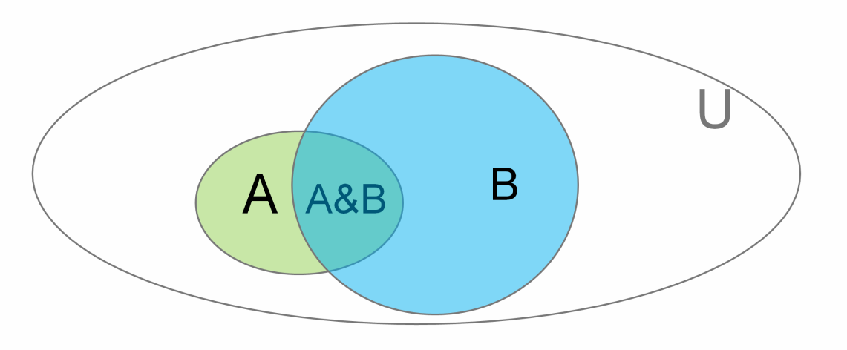
An Alternative: The Elegance of Statistics
We write P(A | B) to denote
“Probability of A given B” (or “… assuming B”)
or
“If we know B is true, what’s the probability of A”

Slide 35
Conditional Probability Example
Consider Jen’s Mobile data:
Location: {Shadyside, NSH, Hidden Valley, Other}
Activity: {Biking, Vehicle, Walking, Still, Other}
Conditional probabilities are useful in classification:
P(Walking| Location=Shadyside)
P(Sleeping | Location=NSH), etc
We can estimate these based on body of prior observations (e.g., count how many times walking when location was Shadyside)

Slide 36
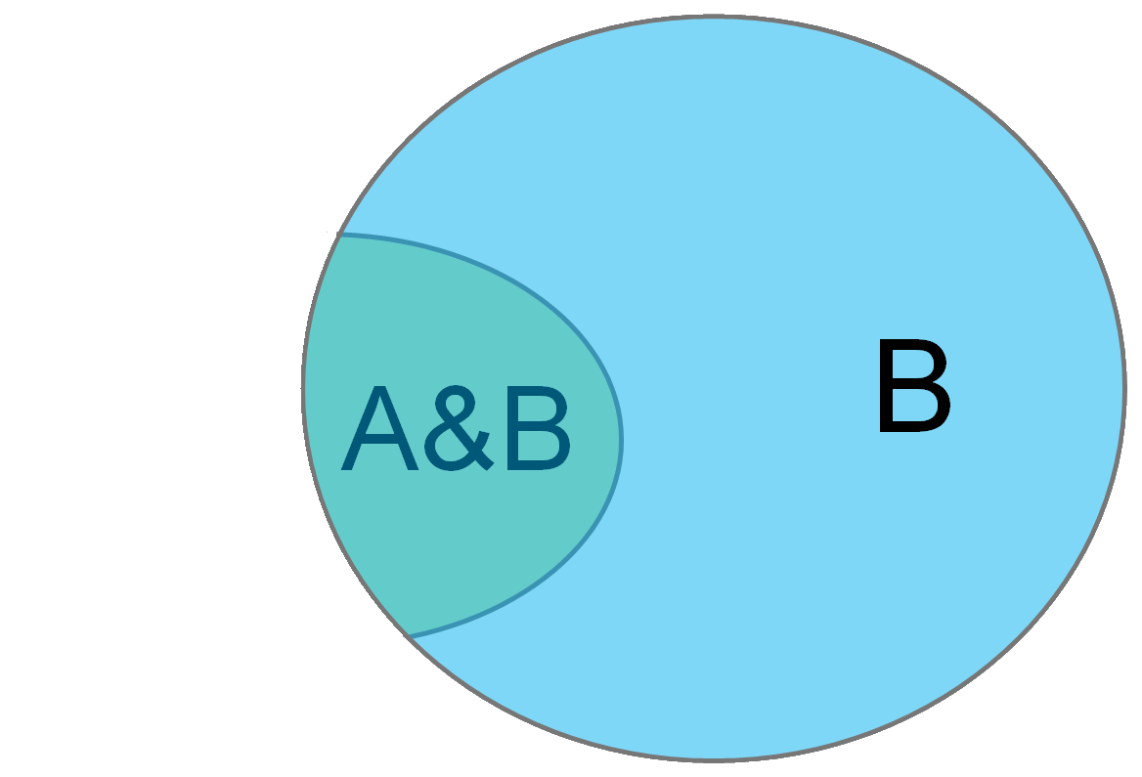
Conditional Probability
P(A | B) - “Probability of A given B”
You can think of this as just a change of universe
Probability of A treating B as the universe
→

Slide 37
Conditional Probability
P(A| B)
= |A&B|
|B|

Slide 38
Conditional Probability
P(A| B)
= |A&B|
|B|
Divide top and bottom by |U| …
|A&B|
= |U| = P(A&B)
|B| P(B)
|U|

Slide 39
Conditional Probability
P(Sleeping | NSH)
= P(Sleeping&NSH)
P(NSH)

Slide 40
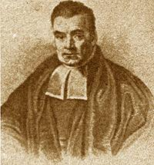
Naïve Bayes
Based on Bayes law
http://en.wikipedia.org/wiki/Bayes'_theorem
http://yudkowsky.net/rational/bayes
http://oscarbonilla.com/2009/05/visualizing-bayes-theorem/
Bayes Law (AKA Bayes theorem):
Rev. Thomas Bayes 1702-1761
P(B | A) P(A)
P(A | B) =
P(B)

Slide 41
Why is that true?

Slide 42
Why is that true?
P(A | B) = P(A&B)
P(B)

Slide 43
Why is that true?
P(A | B) = P(A&B)
P(B) → P(A | B)P(B)= P(A&B)

Slide 44
Why is that true?
P(A | B) = P(A&B)
P(B) → P(A | B)P(B)= P(A&B)
Now the converse
P(B | A) = P(A&B)
P(A) → P(B | A)P(A)= P(A&B)

Slide 45
Why is that true?
P(A | B) = P(A&B)
P(B) → P(A | B)P(B)= P(A&B)
Now the converse
P(B | A) = P(A&B)
P(A) → P(B | A)P(A)= P(A&B)
P(A | B)P(B) = P(B | A)P(A)

Slide 46
Why is that true?
P(A | B) = P(A&B)
P(B) → P(A | B)P(B)= P(A&B)
Now the converse
P(B | A) = P(A&B)
P(A) → P(B | A)P(A)= P(A&B)
P(A | B)P(B) = P(B | A)P(A) divide by P(B)

Slide 47
Why is that true?
P(A | B) = P(A&B)
P(B) → P(A | B)P(B)= P(A&B)
Now the converse
P(B | A) = P(A&B)
P(A) → P(B | A)P(A)= P(A&B)
P(A | B)P(B) = P(B | A)P(A) divide by P(B)
P(B | A) P(A)
P(A | B) =
P(B)

Slide 48
Bayes Law
Bayes Law (AKA Bayes theorem):
Rev. Thomas Bayes 1702-1761
P(B | A) P(A)
P(A | B) =
P(B)

Slide 49
Bayes Law
Bayes Law (AKA Bayes theorem):
Rev. Thomas Bayes 1702-1761
P(NSH | Sleeping) P(Sleeping)
P(Sleeping | NSH) =
P(NSH)

Slide 50
Bayes Law
Bayes Law (AKA Bayes theorem):
Rev. Thomas Bayes 1702-1761
P(NSH | Sleeping) P(Sleeping)
P(Sleeping | NSH) =
P(NSH)

Slide 51
Naïve Bayes
Would like to know the probability that the true class is C_{i} given the occurrence of observed feature vector F = <f₁, f₂, …, f_{n} >
Compute as:
P(F | C_{i}) P(C_{i})
Likelihood * Prior
P(C_{i} | F) =
=
P(F)
Evidence

Slide 52
Naïve Bayes
Would like to know the probability that the true class is C_{i} given the occurrence of observed feature vector F = <f₁, f₂, …, f_{n} >
Compute as:
Class C_{x} with the highest computed probability is used as the classification result
P(F | C_{i}) P(C_{i})
Likelihood * Prior
P(C_{i} | F) =
=
P(F)
Evidence

Slide 53
Small Issues
What happens when C_{i} never occurs in the training data?
P(C_{i}) = 0, therefore C_{i} never wins & is never selected!
(A common variant puts a minimum on P(C_{i}) to avoid this, but in general rare events can be hard to handle well)
We have implicitly assumed F_{k} comes from a discrete set e.g., so we can simply count the occurrences to compute P(F_{k} | C_{i})
There are good ways to quantize (pick good “bins”) for e.g., numeric features automatically, but we won’t cover this

Slide 54
Naïve Bayes Pros and Cons
Elegant balance of features and prior probabilities
But depends on assumptions that are not in general true
Will tend to fail when things are highly conditional
i.e., System behaves very differently when X is true vs. Y is true
Works less well when attributes are redundant or classes are skewed (priors win)
Robust when features are missing (because of prior probabilities)
Notes:
In practice statistical approach doesn’t work better than “ad-hoc” methods

Slide 55
Naïve Bayes vs Decision Trees
Decision Trees use contingencies between patterns of attribute values as a basis for decision making
Naïve Bayes treats attributes as independent pieces of evidence that the decision should go one way or another
Most of the time in real data sets the values of the different attributes are not independent of each other

